Slide 1
Selenium using Java

Slide 2
Selenium Goals
Selenium IDE
Locators
Selenium Web Driver
Architecture
Design Patterns
Finding Elements
Working with GUI Controls
TestNG
Selenium Grid
ANT
Jenkins Integration

Slide 3
Getting Started with Selenium IDE
Selenium is one of the most well known testing frameworks in the world that is in use.
It is an open source project that allows testers and developers alike to develop functional tests to drive the browser.
It can be used to record workflows so that developers can prevent future regressions of code.
Selenium can work on any browser that supports JavaScript, since Selenium has been built using JavaScript.

Slide 4
Getting Started with Selenium IDE
A set of tools that supports rapid development of test automation for web-based applications.
Can be recorded and written as HTML
Support for a number of programming languages: Java, C#, Perl, PHP, Python, Ruby
Cross browsers support: IE, Firefox, Opera, Safari and Google Chrome
Cross platform support: Windows, Linux, and Macintosh.

Slide 5
Getting Started with Selenium IDE
Invented in 2004 by Jason R. Huggins and team.
Originally named JavaScript Functional Tester [JSFT] 100% Javascript and HTML
Designed to make test writing easy
Open source browser based integration test framework built originally by ThoughtWorks
Selenium is open source software, released under the Apache 2.0 license and can be downloaded and used without charge.

Slide 6
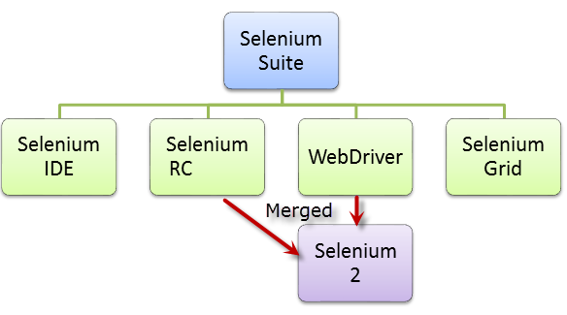

Slide 7
Getting Started with Selenium IDE
Selenium IDE is a Firefox Add-on developed originally by Shinya Kasatani as a way to use the original Selenium Core code without having to copy Selenium Core onto the server.
Selenium Core is the key JavaScript modules that allow Selenium to drive the browser.
It has been developed using JavaScript so that it can interact with DOM (Document Object Model) using native JavaScript calls.
Selenium IDE was developed to allow testers and developers to record their actions as they follow the workflow that they need to test.

Slide 8
Installing Selenium IDE
1. Go to http://seleniumhq.org/download/.
2. Click on the download link for Selenium IDE. You may see a message appear saying Firefox prevented this site (seleniumhq.org) from asking you to install software on your computer. If you do, click the Allow button.

Slide 9
Installing Selenium IDE
Once the install process is complete it will ask you to restart Firefox.
Click the Restart Now button. Firefox will close and then re-open.
If you have anything open in another browser it might be worth saving your work, as Firefox will try to go back to its original state but this cannot be guaranteed.

Slide 10
Selenium IDE

Slide 11
Selenium IDE

Slide 12
Selenium IDE

Slide 13
Selenium IDE

Slide 14
Rules for automation
Tests should always have a known starting point.
In the context of Selenium, this could mean opening a certain page to start a workflow.
 Tests should not have to rely on any other tests to run. If a test is going to add something, do not have a separate test to delete it.
This is to ensure that if something goes wrong in one test, it will not mean you have a lot of unnecessary failures to check.
Tests should only test one thing at a time.
Tests should clean up after themselves.

Slide 15
Recording your first test with Selenium IDE
To start recording the tests we will need to start Mozilla Firefox.
Once it has been loaded, you will need to start Selenium IDE.
You will find it under the Tools dropdown menu in Mozilla Firefox or in the Web Developer dropdown menu.
Once loaded it will look like the next screenshot. Note that the record button is engaged when you first load the IDE.

Slide 16
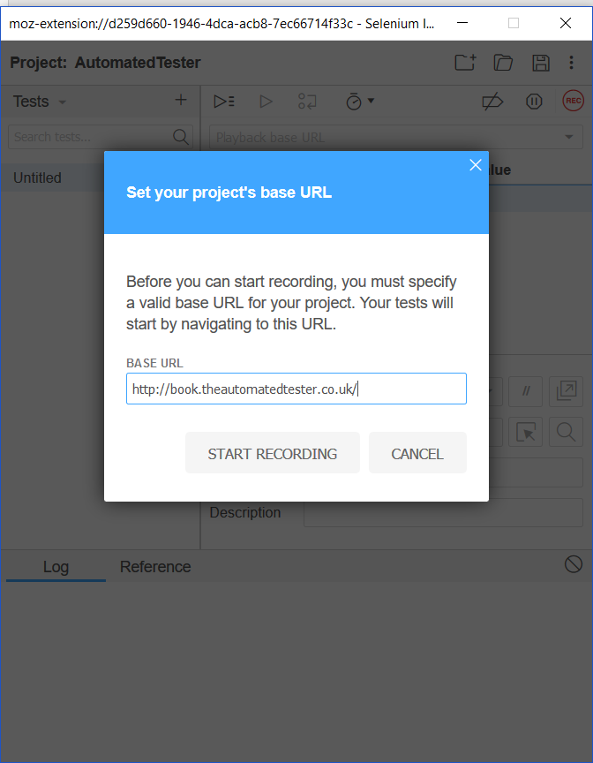
Recording your first test with Selenium IDE

Slide 17
verify and assert methods
 verifyElementPresent
 assertElementPresent
 verifyElementNotPresent
 assertElementNotPresent
 verifyText
 assertText
 verifyAttribute
 assertAttribute
 verifyChecked
 assertChecked
 verifyAlert
 assertAlert
 verifyTitle
 assertTitle

Slide 18
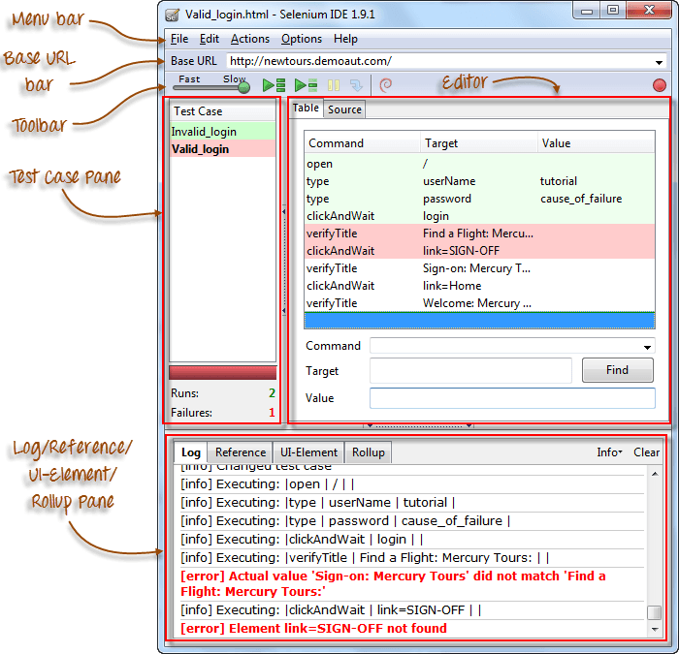
Selenium IDE

Slide 19
Introduction to Selenium Commands - Selenese
3 Types of Commands
Actions | These are commands that directly interact with page elements. Example: the "click" command is an action because you directly interact with the element you are clicking at. The "type" command is also an action because you are putting values into a text box, and the text box shows them to you in return. There is a two-way interaction between you and the text box.

Slide 20
Introduction to Selenium Commands - Selenese
3 Types of Commands
Accessors | They are commands that allow you to store values to a variable. Example: the "storeTitle" command is an accessor because it only "reads" the page title and saves it in a variable. It does not interact with any element on the page.

Slide 21
Introduction to Selenium Commands - Selenese
3 Types of Commands
Assertions | They are commands that verify if a certain condition is met. 3 Types of Assertions Assert. When an "assert" command fails, the test is stopped immediately. Verify. When a "verify" command fails, Selenium IDE logs this failure and continues with the test execution. WaitFor. Before proceeding to the next command, "waitFor" commands will first wait for a certain condition to become true. If the condition becomes true within the waiting period, the step passes. If the condition does not become true, the step fails. Failure is logged, and test execution proceeds to the next command. By default, the timeout value is set to 30 seconds. You can change this in the Selenium IDE Options dialog under the General tab.

Slide 22
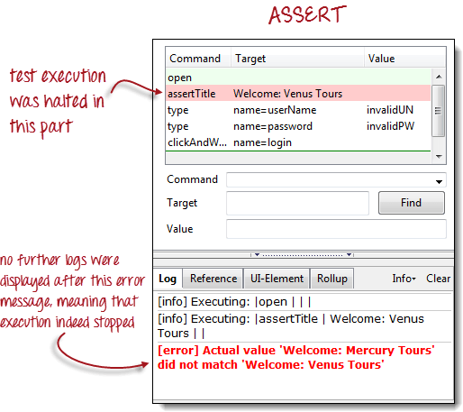

Slide 23
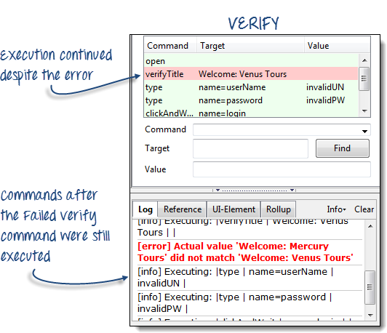

Slide 24
Command | Number of Parameters | Description
open | 0 - 2 | Opens a page using a URL.
click/clickAndWait | 1 | Clicks on a specified element.
type/typeKeys | 2 | Types a sequence of characters.
verifyTitle/assertTitle | 1 | Compares the actual page title with an expected value.
verifyTextPresent | 1 | Checks if a certain text is found within the page.
verifyElementPresent | 1 | Checks the presence of a certain element.
verifyTable | 2 | Compares the contents of a table with expected values.
waitForPageToLoad | 1 | Pauses execution until the page is loaded completely.
waitForElementPresent | 1 | Pauses execution until the specified element becomes present.

Slide 25
Locators
Locators allow us to find elements on a page that can be used in our tests.
Locate elements by ID
 Locate elements by Name
 Locate elements by Link
 Locate elements by XPath
 Locate elements by CSS
 Locate elements by DOM

Slide 26
Locating elements by ID
On web applications today, elements should have an ID attribute for all their controls on the page.
A control would be an element that we can interact with and is not static text.
This allows Selenium to find the unique item, since IDs should be unique, and then complete the action that it needs to do against that element.

Slide 27
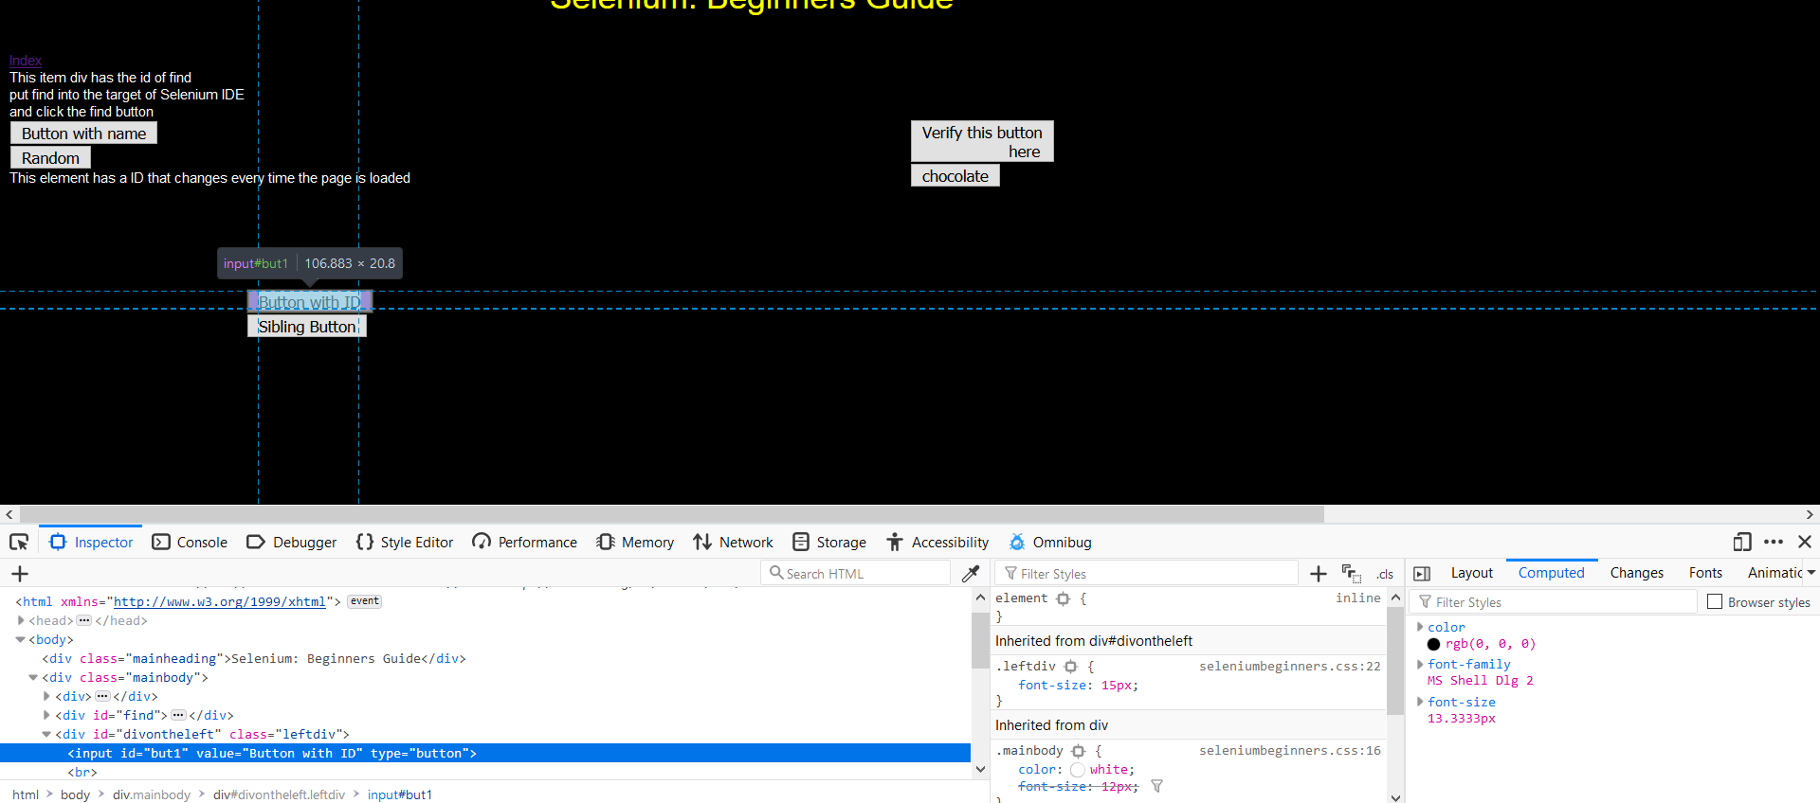
Locating elements by ID

Slide 28
Locating elements by ID

Slide 29
finding elements by name

Slide 30
Adding filters to the name
There are times when there may be elements on the page that have the same name but a different attribute.
When this happens we can apply filters to the locator so that Selenium IDE can find the element that we are after.

Slide 31
finding elements by link text
Probably the most common element on a page is a link.
Links allow pages to be joined together so end users can navigate your site with confidence.
You can see a screenshot of the element being found in Selenium IDE.

Slide 32
finding elements by accessing the DOM via JavaScript
There are times where the DOM will be updated via AJAX and this means that our locator needed for the test will need some form of JavaScript to see if it is there.
In JavaScript, calling the DOM to find the first link on the page would look like document.links[0];. document represents the HTML document and links is an array on that object.

Slide 33
finding elements by XPath
XPath allows us to query the DOM as though it were an XML document.
With XPath we can do some rather complex queries to find elements on the page that may not have been accessible otherwise.

Slide 34
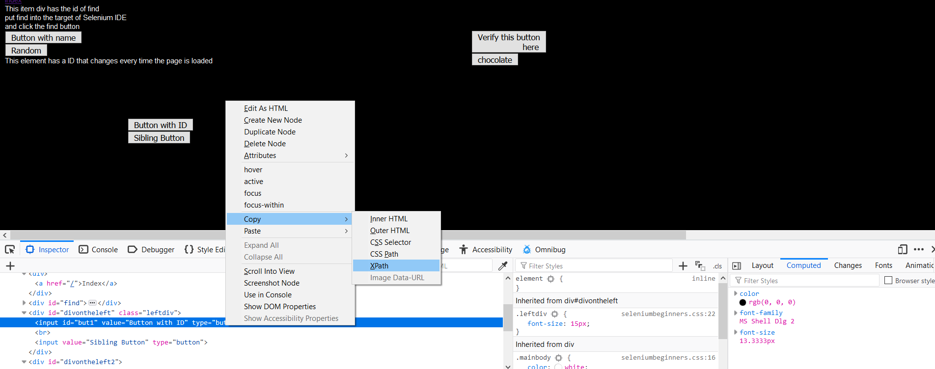
finding elements by XPath

Slide 35
Finding an element by the text it contains
Finding elements by the text they contain can be quite useful when working with web pages that have been created dynamically.
The elements could be from using a web based WYSIWYG editor or you might just like to find a paragraph on the page with specific text to then do further queries on.
To do this your query will need to have the text() method call in the query.
It will match the entire contents of the node if it has the format //element[text()='inner text'].

Slide 36
Finding an element by the text it contains

Slide 37
Finding an element by the text it contains

Slide 38
CSS selectors
So, finding elements by XPath can be an extremely costly exercise.
A way around this is to use CSS selectors to find the objects that you need. Selenium is compatible with CSS 1.0, CSS 2.0, and CSS 3.0 selectors.
There are a number of items that are supported like namespace in CSS 3.0 and some pseudo classes and pseudo elements.

Slide 39
CSS selectors

Slide 40
Selenium WebDriver
WebDriver on the other hand tries to control the browser from outside the browser. It uses accessibility API to drive the browser.
The accessibility API is used by a number of applications for accessing and controlling applications when they are used by disabled users and is common to web browsers.
WebDriver uses the most appropriate way to access the accessibility API. If we look at Firefox, it uses JavaScript to access the API.
If we look at Internet Explorer, it uses C++. This approach means we can control browsers in the best possible way but has the downside that new browsers entering the market will not be supported straight away like we can with Selenium RC.

Slide 41
WebDriver API
The WebDriver API is the part of the system that you interact with all the time.
Things have changed from the 140 line long API that the Selenium RC API had.
This is now more manageable and can actually fit on a normal screen.
This is made up of the WebDriver and the WebElement objects.
driver.findElement(By.name("q"))
and
element.sendKeys("I love cheese");
These commands are then translated to the SPI, which is stateless.

Slide 42
WebDriver API
The WebDriver API is the part of the system that you interact with all the time.
Things have changed from the 140 line long API that the Selenium RC API had.
This is now more manageable and can actually fit on a normal screen.
This is made up of the WebDriver and the WebElement objects.
driver.findElement(By.name("q"))
and
element.sendKeys("I love cheese");
These commands are then translated to the SPI, which is stateless.

Slide 43
Web Driver API
Read Browser Details:
driver.getTitle();
driver.getWindowHandle();
driver.getWindowHandles();
driver.getCurrentUrl();
driver.getPageSource();

Slide 44
Web Driver API
Go to a specified URL:
driver.get(“http://google.com”)
driver.navigate().to(“http://google.com”)
driver.navigate().to(new URL(“http://google.com”))
driver.navigate().back()
driver.navigate().forward()
driver.navigate().refresh()

Slide 45
Web Driver API
driver.findElement(By) – To find the first element matching the given locator argument. Returns a WebElement
driver.findElements(By) – To find all elements matching the given locator argument. Returns a list of WebElement

Slide 46
Web Driver API
By ID
<input id=”q” type=”text”>…</input>
WebElement element = driver.findElement(By.id(“q”))
By Name
<input id=”q” name=”search” type=”text” />
WebElement element = driver.findElement(By.name(“search”));
By Class Name
<div class=”username” style=”display: block;”>…</div>
WebElement element = driver.findElement(By.className(“username”));
By Tag Name
<div class=”username” style=”display: block;”>…</div>
WebElement element = driver.findElement(By.tagName(“div”));

Slide 47
Web Driver API
By Link Text
<a href=”#”>Refresh</a>
WebElement element = driver.findElement(By.linkText(“Refresh”));
By Partial Link Text
<a href=”#”>Refresh Here</a>
WebElement element = driver.findElement(By.partialLinkText(“Refresh”));
By XPath
<form id=”testform” action=”submit” method=”get”>
Username: <input type=”text” />
Password: <input type=”password” />
</form>

Slide 48
Web Driver API
WebElement element = driver.findElement(By.xpath(“//form[@id=’testform’]/input[1]”));
By CSS Selector
<form id=”testform” action=”submit” method=”get”>
<input class=”username” type=”text” />
<input class=”password” type=”password” />
</form>
WebElement element = driver.findElement(By.cssSelector(“form#testform>input.username”));

Slide 49
Web Driver API
Java Selenium commands for operation on Elements:
button/link/image:
click() getAttribute() isDisplayed() isEnabled()
Text field:
sendKeys() clear()
Checkbox/Radio:
isSelected() click()

Slide 50
Web Driver API
Select:
Select select = new Select(WebElement);
select.selectByIndex();
select.selectByValue();
select.selectByVisibleText();
select.deselectAll();
select.deselectByIndex();
select.deselectByValue();
select.deselectByVisibleText();
getFirstSelectedOption()
getAllSelectedOptions() – Returns List

Slide 51
Web Driver API
Element properties:
isDisplayed()
isSelected()
isEnabled()
Read Attribute:
getAttribute(“”)
Get attribute from a disabled text box
driver.findElement(By).getAttribute(“value”);

Slide 52
Web Driver API
Screenshot:
image storage without using any extra libraries.
TakesScreenshot takeScreenshot = (TakesScreenshot) driver;
File file = takeScreenshot.getScreenshotAs(OutputType.FILE);
FileInputStream fis = new FileInputStream(file);
FileOutputStream fos = new FileOutputStream(new File(System.getProperty("user.dir")+"/test.jpg"));
int cursor;
while((cursor=fis.read())!=-1) {
fos.write(cursor);
}
fos.close();
fis.close();

Slide 53
TEST NG Framework
TestNG is an automation testing framework in which NG stands for "Next Generation".
TestNG is inspired from JUnit which uses the annotations (@).
Using TestNG you can generate a proper report, and you can easily come to know how many test cases are passed, failed and skipped.
You can execute failed test case separately.

Slide 54
TEST NG Framework
TestNG is an automation testing framework in which NG stands for "Next Generation".
TestNG is inspired from JUnit which uses the annotations (@).
Using TestNG you can generate a proper report, and you can easily come to know how many test cases are passed, failed and skipped.
You can execute failed test case separately.
The TestNG provides an option, i.e., testng-failed.xml file in test-output folder.

Slide 55
Why TEST NG Framework
Generate the report in a proper format including a number of test cases runs, the number of test cases passed, the number of test cases failed, and the number of test cases skipped.
Multiple test cases can be grouped more easily by converting them into testng.xml file. In which you can make priorities which test case should be executed first.
The same test case can be executed multiple times without loops just by using keyword called 'invocation count.'
Using testng, you can execute multiple test cases on multiple browsers, i.e., cross browser testing.
The testing framework can be easily integrated with tools like Maven, Jenkins, etc.

Slide 56
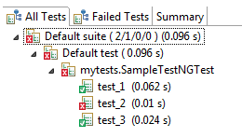
Why TEST NG Framework
Annotations used in the testing are very easy to understand ex: @BeforeMethod, @AfterMethod, @BeforeTest, @AfterTest
WebDriver has no native mechanism for generating reports. TestNG can generate the report in a readable format like the one shown below.

Slide 57
Why TEST NG Framework
There are three major advantages of TestNG over JUnit:
Annotations are easier to understand
Test cases can be grouped more easily
Parallel testing is possible

Slide 58
TestNG Annotations
@BeforeSuite: The annotated method will be run before all tests in this suite have run.
@AfterSuite: The annotated method will be run after all tests in this suite have run.
@BeforeTest: The annotated method will be run before any test method belonging to the classes inside the tag is run.

Slide 59
TestNG Annotations
@AfterTest: The annotated method will be run after all the test methods belonging to the classes inside the tag have run.
@BeforeGroups: The list of groups that this configuration method will run before. This method is guaranteed to run shortly before the first test method that belongs to any of these groups is invoked.
@AfterGroups: The list of groups that this configuration method will run after. This method is guaranteed to run shortly after the last test method that belongs to any of these groups is invoked.

Slide 60
TestNG Annotations
@BeforeClass: The annotated method will be run before the first test method in the current class is invoked.
@AfterClass: The annotated method will be run after all the test methods in the current class have been run.
@BeforeMethod: The annotated method will be run before each test method.
@AfterMethod: The annotated method will be run after each test method.
@Test: The annotated method is a part of a test case

Slide 61
Page Object
Page Object Model is a Design Pattern which has become popular in Selenium Test Automation.
It is widely used design pattern in Selenium for enhancing test maintenance and reducing code duplication.
Page object model (POM) can be used in any kind of framework such as modular, data-driven, keyword driven, hybrid framework etc.
A page object is an object-oriented class that serves as an interface to a page of your Application Under Test(AUT).

Slide 62
Page Object
Page Object Model is a design pattern to create Object Repository for web UI elements.
Under this model, for each web page in the application, there should be corresponding page class.
This Page class will find the WebElements of that web page and also contains Page methods which perform operations on those WebElements.
Name of these methods should be given as per the task they are performing, i.e., if a loader is waiting for the payment gateway to appear, POM method name can be

Slide 63
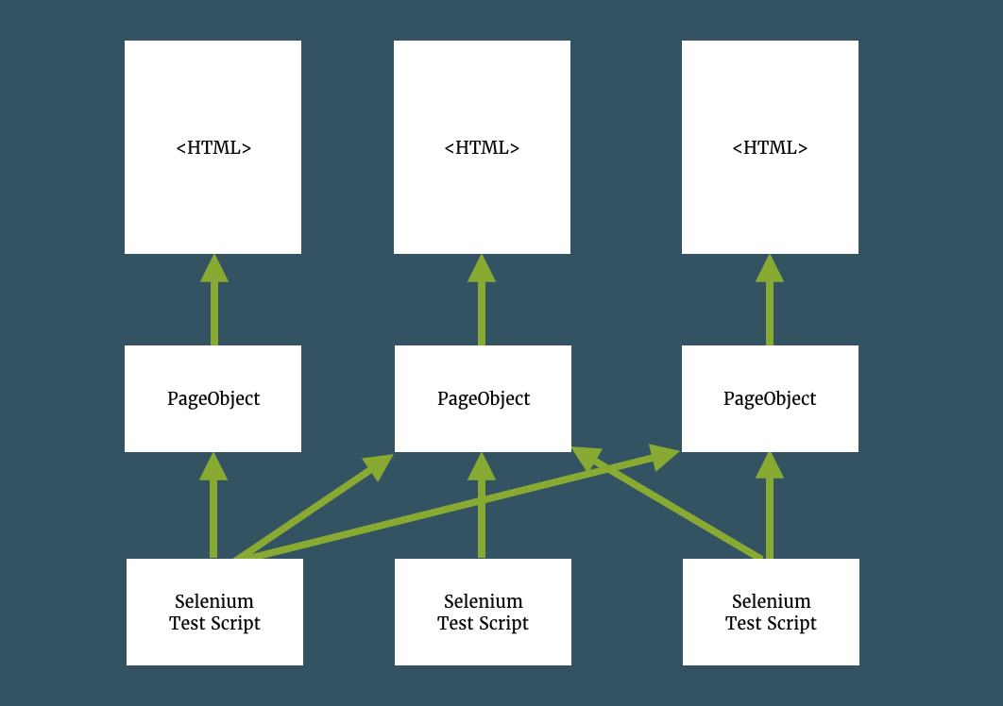
Page Object

Slide 64
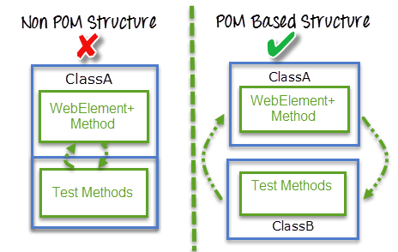
Page Object
A better approach to script maintenance is to create a separate class file which would find web elements, fill them or verify them.
This class can be reused in all the scripts using that element. In future, if there is a change in the web element, we need to make the change in just 1 class file and not 10 different scripts.

Slide 65
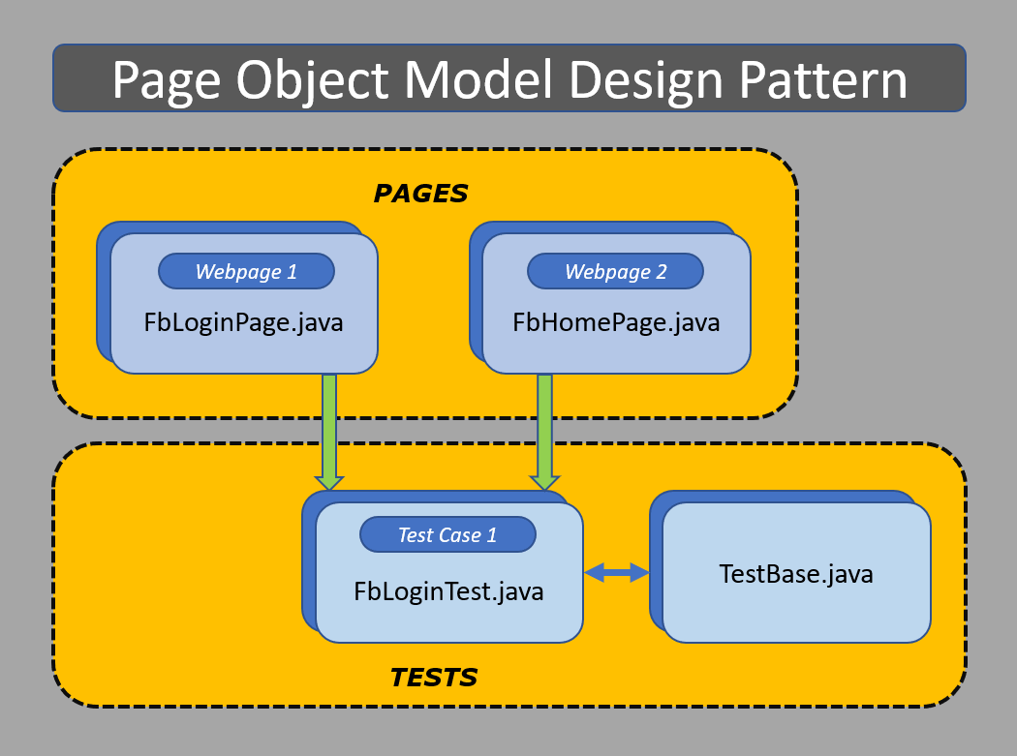
Page Object

Slide 66
Page Factory
We have seen that ‘Page Object Model’ is a way of representing an application in a test framework.
For every ‘page’ in the application, we create a Page Object to reference the ‘page’ whereas a ‘Page Factory’ is one way of implementing the ‘Page Object Model’.
Page Object is a class that represents a web page and hold the functionality and members.
Page Factory is a way to initialize the web elements you want to interact with within the page object when you create an instance of it.

Slide 67
Page Object
The tests then use the methods of this page object class whenever they need to interact with the User Interface (UI) of that page.
The benefit is that if the UI changes for the page, the tests themselves don’t need to change, only the code within the page object needs to change.
Subsequently, all changes to support that new UI is located in one place.

Slide 68
Advantages
Code reusability – We could achieve code reusability by writing the code once and use it in different tests.
Code maintainability – There is a clean separation between test code and page specific code such as locators and layout which becomes very easy to maintain code.
Code changes only on Page Object Classes when a UI change occurs. It enhances test maintenance and reduces code duplication.
Object Repository – Each page will be defined as a java class. All the fields in the page will be defined in an interface as members. The class will then implement the interface.
Readability – Improves readability due to clean separation between test code and page specific code

Slide 69
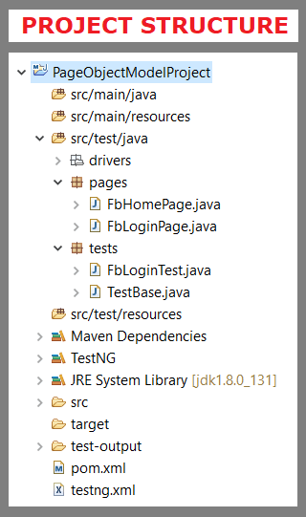
Page Object
Scenario: Enter valid credentials in the ‘Facebook Login’ Page and redirects to the ‘Facebook Home‘ Page.

Slide 70
Questions

Slide 71
Module Summary
Lambdas
Stream API
Base 64
Nashorn
Reflection
Date Time API
Repeated Annotations
JDBC Improvements

